Slide 1


Welcome to
Year 4

Slide 2

Meet the team
The Leadership Team
Miss Waterhouse - Headteacher
Mrs Hooker - Deputy Head (DSL)
Mr Proffitt - Inclusion Leader
Year 4 Teachers
Mr Doman - Year 4 Leader 4D
Mrs Green- 4G
Miss Sinfield-Abbott- 4S
Mrs Adams - HLTA
Notes:
Awkward stand a wave

Slide 3
Teaching Assistants
Mrs Hart
Mrs Ballett
Mrs Kirkby
Mrs Singleton
Pastoral Care Team
Mrs Kilahena
Mrs Wilson (ELSA Support)

Slide 4
Rights Respecting
Gold Rights Respecting School.
Recognise and support the rights of all children, irrespective of race, religion, ability or gender.
Aim to improve self esteem, enhance moral and academic development, improve relationships and behaviour, reduce prejudice and develop global citizenship.

Slide 5
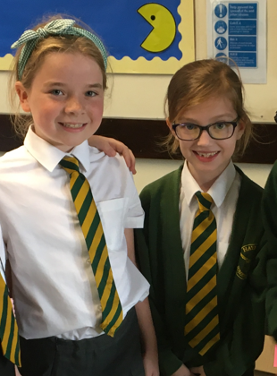
Uniform
Green jumper or cardigan with logo.
Plain white short or long-sleeved school shirt with collar. Tucked in and buttoned up at the neck.
Green and yellow striped tie clip on or tie.
Grey, black or charcoal tailored school trousers.
Grey, black or charcoal knee length skirts.
Plain grey, black or white socks or tights.
Green and white striped or checked dress - knee length (Summer only)
Traditional black low heeled school shoes. Velcro, laces, buckle or slip on only.
Notes:
Please do talk to us about any issues with homework. We know this can be challenging area and are more than happy to help.

Slide 6
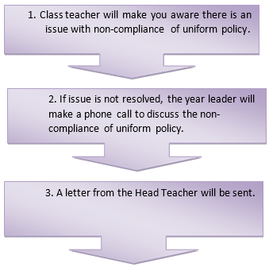
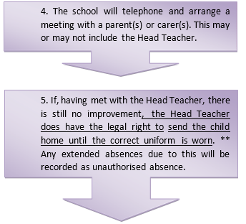
Uniform
All pupils are expected to wear the appropriate uniform from home to school and home again, except when permission has been given because of school educational visits, or pre-arranged activity days, such as Comic Relief or non-uniform days. All pupils are representing the school at all times and should take pride in being part of their community.
If your child does attend school in uniform which does not conform to the agreed school policy, please note the following procedures will be followed:

Slide 7
Curriculum and assessments
Follow the National Curriculum.
Greater links across the curriculum.
Maths curriculum
Children are assessed according to whether they are ‘working towards’, ‘working at’ or ‘working above’ the age related targets from the NC.
We have a system in place to track and monitor each child’s attainment.

Slide 8
Special Educational Needs
If your child needs additional support in school then the class teacher or Mr Proffitt will contact you.
If you feel your child needs additional support in school please contact the class teacher.
If your child is on the SEN register they will have additional targets set which will be shared with you during a separate meeting.
Targets reviewed once per term.

Slide 9
Attendance
Of pupils who fall below 50% attendance, only 3% will achieve five A-C equivalent GCSE grade (including English and maths).
Of pupils who fall within 80 and 90% attendance, only 35% will achieve five A-C equivalent GCSE grade (including English and maths).
Of pupils who fall below 95% attendance, only 73% will achieve five A-C equivalent GCSE grade (including English and maths).
All children need to attend school and all children need to attend school on time.
We are here to help and support you in getting this right. If we are concerned about your child’s attendance, we will speak to you.

Slide 10
The School Week
Daily maths lessons and 4 reading and writing lessons.
Daily Newsround.
Library visit is on a Thursday.
Two hours PE every week (indoor and outdoor) on a Tuesday.
Computing, RE, French, Music, Science and PSHE lessons weekly.
Art, DT, History and Geography will be taught according to topic.

Slide 11

Reading Expectations
Year 4 are expected to read at least 4 times per week for at least 20 minutes each time.
Ideally, they read to an adult, but we do understand that this is not always possible.
Book bands - children are assessed for their BB level and they can change their books daily
Children should read their BB book on these 4 (or more) occasions. They can read a book of their choice the rest of the time if they choose to.
Please record this in the diary.
We celebrate the children’s home-reading efforts at the end of every half term.
Opportunity to read at lunchtime.

Slide 12
Homework
English and maths set on Thursdays and are due in on Wednesday. This will be using an online website called ‘Atom Learning’ for Maths and every other week for English which will also be set in an English book to go home.
Spellings are set on Friday, tested on Thursday and homework due in on Thursday.
TT Rockstars homework
20 minutes of reading at home - 4 times a week.
Homework diary signed by an adult every time they read.
Home Learning Projects are set half termly for each new topic.

Slide 13
How Can You Help?
Make sure homework is completed on either Atom Learning and their spelling book.
Keep reading with your children and sign the reading record. They should be reading their BB book and changing when finished.
Keep talking to us about how things are going! Communicate in diaries and meetings can be arranged through the office or the class teacher.

Slide 14
Rewards
All pupils have been allocated a house that they represent. House points will be awarded for good work and progress.
To reward good behaviour children will receive Dojo points on Class Dojo. The children will be randomly chosen, weighted by the number of points they have.
Good to be Green cards
Achievements are also recognised during a weekly celebration assembly and year assembly.

Slide 15
Consequences - opportunity
If children show behaviour that is not rights respecting and does not follow the behaviour policy then they will be given a verbal warning. If their behaviour doesn’t improve, they will be given a yellow card. They can earn their way off the yellow card but if they do not then they will miss some of their break or lunch.
If their behaviour is especially unacceptable then their name will go on the red card and they will go into another year group for a lesson or longer.
A room is supervised by a member of the team at lunchtime for opportunity, given for the following reasons:
  Homework catch-up
  Making the wrong choices
  A reading opportunity

Slide 16
Multiplication Tables Check
(MTC)
Statutory times tables check at the end of Year 4 - within 3-week period from beginning of June
Children will be well prepared for the check. We will have dedicated computing sessions for TT Rockstars each week and support during maths lessons.
Notes:
You will be bored of this by the end of the year

Slide 17
What does the MTC look like and how is it administered?
25 questions and are given 6 seconds to write an answer.
Around 5 minutes to complete the test.
It only tests multiplication.

Slide 18
What can you do to help?
TT Rockstars is a really valuable resource for quick practise of the times tables.
Encourage your children to use the number pad.
Flash Cards
Quick fire questions on the way to school and out and about.
Ask questions out of sequence.
Chanting
Songs - there are a wealth of resources online (Spotify, YouTube and CDs)

Slide 19
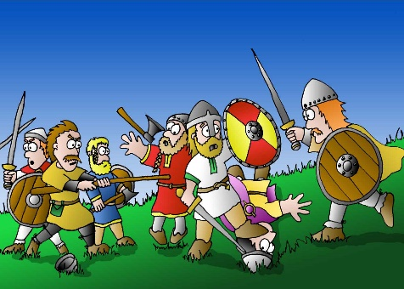

Autumn Term Topics
The Smashing Saxons and Vicious Vikings
Viking Day/Activities - Viking or Saxon costume needed. 10th September 2024
How to Train Your Dragon
Winter Wonderland
This topic will involve sewing Christmas decorations and creating Winter artwork.
Winter Wonderland Performance
Notes:
Be ready to get making costumes!

Slide 20

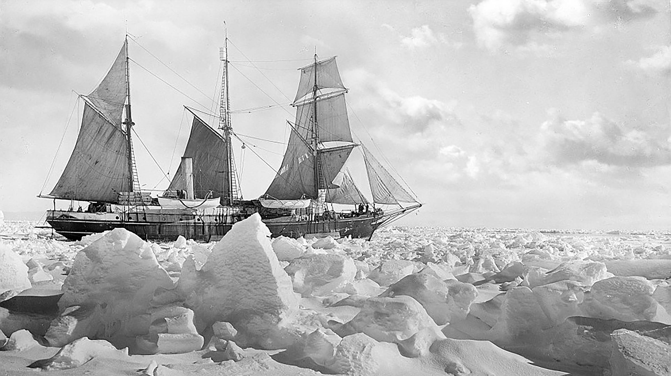
Spring Term Topics
History and Mystery of Brownsea Island
Suspense story writing and information texts.
We’re hopeful that we will be able to go on our regular boat trip around Brownsea Island.
Ice Trap
Ernest Shackleton and his adventures
Survival Day
Notes:
Look forward to the costumes – eskimo

Slide 21


Summer Term Topics
Excellent Egyptians and Fantastic Pharaohs
Visitor with artefacts and dress up
Adventure story
Eco-Warriors
Visitor from Wessex Water
Hengistbury Head trip
Notes:
Wessex Water

Slide 22
Communication
Letters will be emailed to you if you have supplied an email address.
All letters are available on the website.
Newsletters every half term
We regularly use text messaging for brief information and reminders.
Please always talk to us! We are here to help.

Slide 23
What do we expect?
Good routines (e.g. remembering PE kit) in order to maximise learning time. Those in after school clubs should bring extra kit so that the PE kits can stay in school wherever possible
Homework done on time and to the best of their best ability - let us know if your child is taking longer than expected or if there has been a problem completing it
A commitment to doing their best and achieving potential in all work
A reflective approach to learning - become life long learners

Slide 24
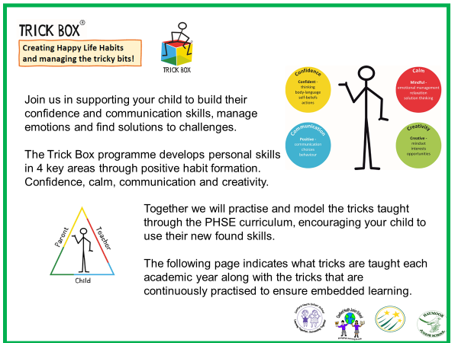

Slide 25
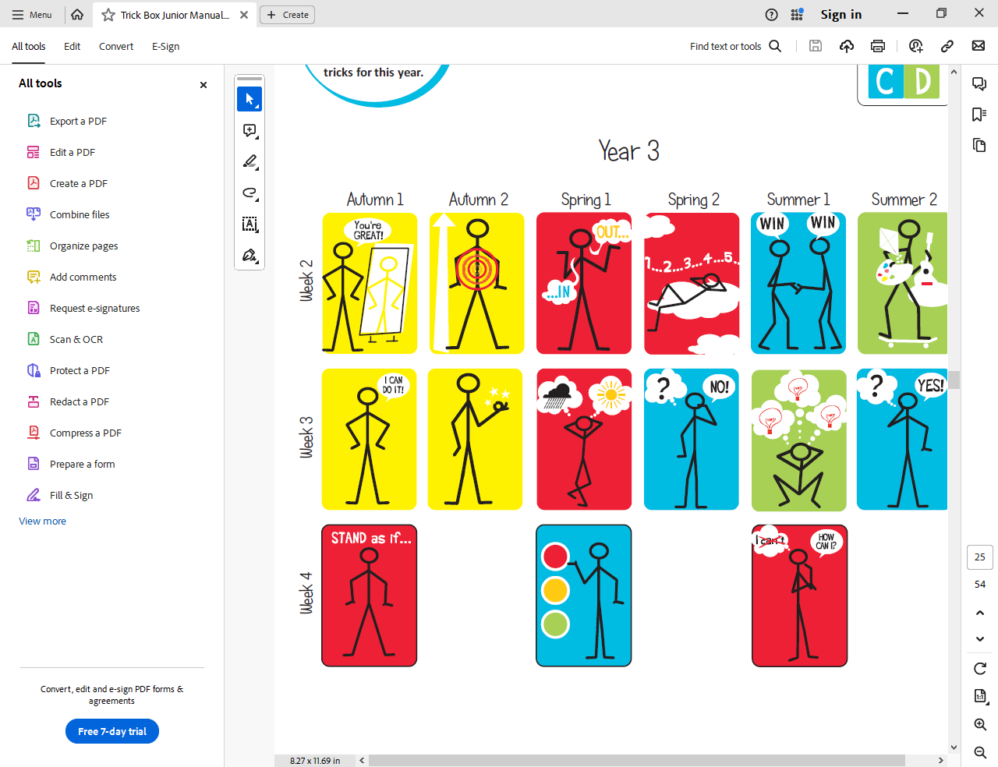












YEAR 3
Autumn
Spring
Summer
Stand as if…
Our mind and bodies work together to help us.
Signal Change
We can choose how we act and behave.
Ask How
Ask ourselves empowering questions
Tell your child about the things they should keep doing – being kind, helping others, sharing.
Refer to the traffic light to signal when your child might need to stop and think about what they are doing. Support them to choose a better option. Make a change!
Stop, think about our choice, make a change.
Replace ‘why’ questions with ‘how’ questions…Instead of ‘Why cant I do this?’, or ‘Why did I not achieve the best result?’ Say ‘How can I do this?’ – ‘How can I do better next time?’.
I can use my cleaver brain to think of ideas to get better and feel good.
Discuss with your child how our bodies can sometimes react to our feelings and thoughts. If we are nervous or worried we can sweat, shake or breathe faster.
Encourage your child to Stand Tall, use their Big Voice and Magic Circle to change their body language and build confidence.
I can stand as if I feel strong and brave.
RECAP

Slide 26

School website - keep up to date!
Please remember to let the office know if your details have changed, because a lot of the communication is done by email.

Slide 27
Thank you for attending!
Any questions?

