Slide 1


Welcome to
Year 5

Slide 2

Meet the team
The Leadership Team
Miss Waterhouse - Headteacher
Miss Hooker - Deputy Head (DSL)
Mr Proffitt - Inclusion Leader
Year 5 Teachers
Mr Clements - Year Leader and Class Teacher 5C
Mrs Davey - Class Teacher 5D
Ms Prince - Class Teacher 5P
Ms Dodd - HLTA
Notes:
Awkward stand a wave

Slide 3
Teaching Assistants
TA - Mrs Ford
SEN TA - Miss Knight
SEN TA - Mrs Stockley
SEN TA – Mrs Carr
SEN TA – Mrs Palmer
Pastoral Care Team
Mrs Killahena
Mrs Wilson (ELSA Support)

Slide 4
Rights Respecting
Gold Rights Respecting School.
Recognise and support the rights of all children, irrespective of race, religion, ability or gender.
Aim to improve self esteem, enhance moral and academic development, improve relationships and behaviour, reduce prejudice and develop global citizenship.

Slide 5
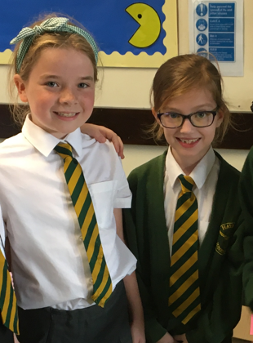
Uniform
Green jumper or cardigan with logo.
Plain white short or long-sleeved school shirt with collar. Tucked in and buttoned up at the neck.
Green and yellow striped tie clip on or tie.
Grey, black or charcoal tailored school trousers.
Grey, black or charcoal knee length skirts.
Plain grey, black or white socks or tights.
Green and white striped or checked dress - knee length (Summer only)
Traditional black low heeled school shoes. Velcro, laces, buckle or slip on only.
Notes:
Please do talk to us about any issues with homework. We know this can be challenging area and are more than happy to help.

Slide 6
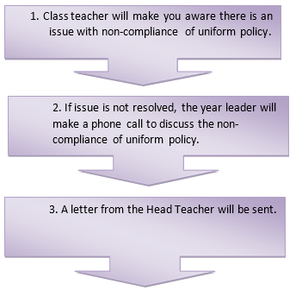
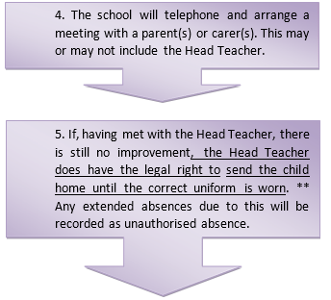
Uniform
All pupils are expected to wear the appropriate uniform from home to school and home again, except when permission has been given because of school educational visits, or pre-arranged activity days, such as Comic Relief or non-uniform days. All pupils are representing the school at all times and should take pride in being part of their community.
If your child does attend school in uniform which does not conform to the agreed school policy, please note the following procedures will be followed:

Slide 7
Curriculum and assessments
Follow the National Curriculum.
Greater links across the curriculum.
Maths curriculum
Children are assessed according to whether they are ‘working towards’, ‘working at’ or ‘working above’ the age related targets from the NC.
We have a system in place to track and monitor each child’s attainment.

Slide 8
Special Educational Needs
If your child needs additional support in school then the class teacher or Mr Proffitt will contact you.
If you feel your child needs additional support in school please contact the class teacher.
If your child is on the SEN register they will have additional targets set which will be shared with you during a separate meeting.
Targets reviewed once per term.

Slide 9
Attendance
Of pupils who fall below 50% attendance, only 3% will achieve five A-C equivalent GCSE grade (including English and maths).
Of pupils who fall within 80 and 90% attendance, only 35% will achieve five A-C equivalent GCSE grade (including English and maths).
Of pupils who fall below 95% attendance, only 73% will achieve five A-C equivalent GCSE grade (including English and maths).
All children need to attend school and all children need to attend school on time.
We are here to help and support you in getting this right. If we are concerned about your child’s attendance, we will speak to you.

Slide 10
The School Week
Daily maths lessons and 4 reading and writing lessons.
Daily Newsround.
Library visit is on a Tuesday.
Two hours PE every week on Monday (indoor and outdoor).
Computing, Religion and Worldviews, French, Music, Science and PSHE lessons weekly.
Art, DT, History and Geography will be taught according to topic.

Slide 11
Reading Expectations
Year 5 are expected to read at least 4 times per week for at least 25 minutes each time.
Ideally, they read to an adult, but we do understand that this is not always possible.
Book bands - children are assessed for their BB level and they can change their books when needed.
Children should read their BB book on these 4 (or more) occasions. They can read a book of their choice the rest of the time if they choose to.
Please record this in the diary along with any words they weren’t sure of.
We celebrate the children’s home-reading efforts at the end of every half term.
Opportunity to read at lunchtime.

Slide 12
Homework
English and maths set on Thursdays and are due in on Wednesday. This will be using an online website called ‘Atom Learning’
Spellings are set on Friday and tested on Thursday homework due in on Friday.
25 minutes of reading at home - 4 times a week.
Homework diary signed by an adult every time they read.
Home Learning Projects are set half termly for each new topic.

Slide 13
How Can You Help?
Make sure homework is completed on either Atom Learning and their spelling book.
Keep reading with your children and sign the reading record. They should be reading their BB book and changing when finished.
Keep talking to us about how things are going! Communicate in diaries and meetings can be arranged through the office or the class teacher.

Slide 14
Rewards
All pupils have been allocated a house that they represent. House points will be awarded for good work and progress.
To reward good behaviour children will receive Dojo points on Class Dojo. The children will be randomly chosen, weighted by the number of points they have.
Good to be Green cards
Achievements are also recognised during a weekly celebration assembly and year assembly.

Slide 15
Consequences - opportunity
If children show behaviour that is not rights respecting and does not follow the behaviour policy then they will be given a verbal warning. If their behaviour doesn’t improve, they will be given a yellow card. They can earn their way off the yellow card but if they do not then they will miss some of their break or lunch.
If their behaviour is especially unacceptable then their name will go on the red card and they will go into another year group for a lesson or longer.
A room is supervised by a member of the team at lunchtime for opportunity, given for the following reasons:
  Homework catch-up
  Making the wrong choices
  A reading opportunity

Slide 16
Autumn Term Topics
What’s out there?
Space Dome
Focus: Science
Marvellous Maya
Focus: History
Notes:
Be ready to get making costumes!

Slide 17
Spring Term Topics
Climb Every Mountain
Focus: Geography
Sewing Bee
Focus: Science and Design Technology
Notes:
Look forward to the costumes – eskimo

Slide 18
Summer Term Topics
Groundbreaking Greeks
Visitor with artefacts and dress up
Focus: History
Come Dine With Me
Cookery!
Focus: Design Technology
Notes:
Wessex Water

Slide 19
Communication
Letters will be emailed to you if you have supplied an email address.
All letters are available on the website.
Newsletters every half term
We regularly use text messaging for brief information and reminders.
Please always talk to us! We are here to help.

Slide 20
What do we expect?
Good routines (e.g. remembering PE kit) in order to maximise learning time. Those in after school clubs should bring extra kit so that the PE kits can stay in school wherever possible
Homework done on time and to the best of their best ability - let us know if your child is taking longer than expected or if there has been a problem completing it
A commitment to doing their best and achieving potential in all work
A reflective approach to learning - become life long learners

Slide 21

School website - keep up to date!
Please remember to let the office know if your details have changed, because a lot of the communication is done by email.

Slide 22
Thank you for attending!
Any questions?

