Slide 1
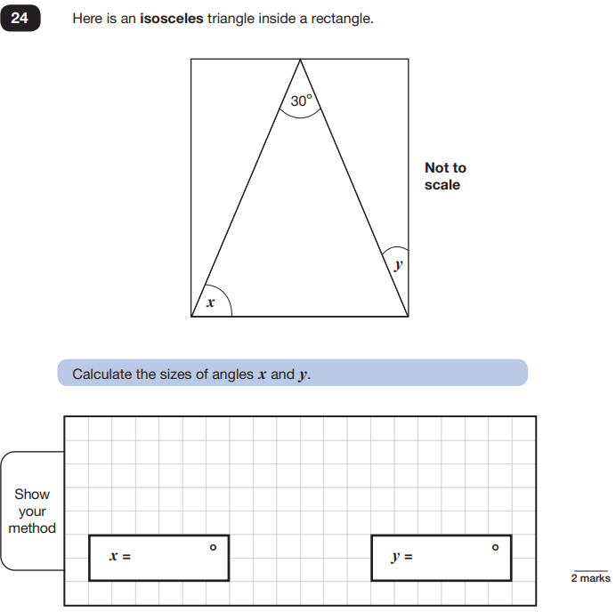
Key Stage Two Tests 2025
A question for you to think about while you are waiting...

Slide 2
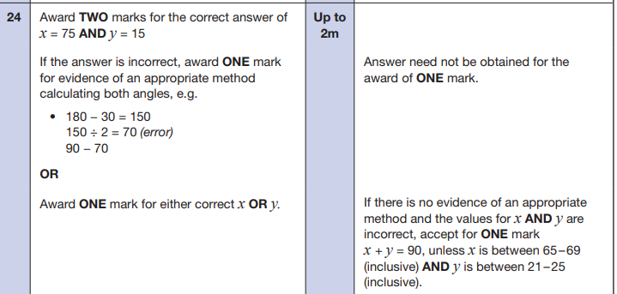
Answer!

Slide 3
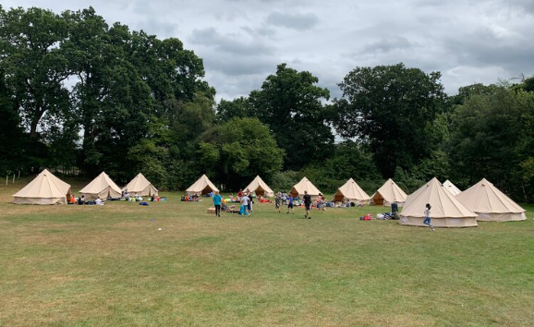

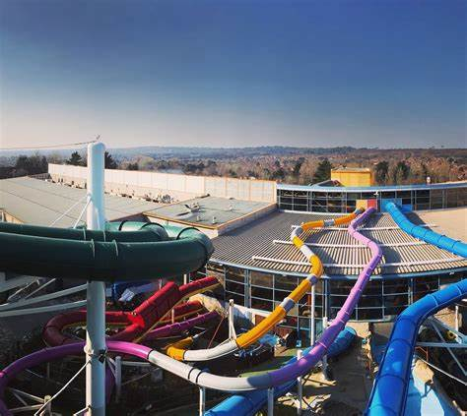
Activities Week 2025
Monday 16th June- Friday 20th June 2025

Slide 4
The week
Monday 16th – Paulton’s Park
Tuesday 17th – South Coast Adventures
Wednesday 18th – Overnight camp with Fresh Air Club
Thursday 19th – Return from camp
Friday 20th - Splashdown

Slide 5
Wednesday 18th June - Day 1 camping
Please bring your child to the hall with the following:
Suitcase.
Hand luggage.
Bedding (inside a bag if possible)
Any medicines (please hand these directly to either Mrs Thornton or Mrs Adams with clearly labelled instructions).
Packed lunch and drink for the first day.
If your child suffers from travel sickness - please ensure they have taken their medication in advance or details are given to our first aiders to administer in school.

Slide 6
First day arrangements
We will be leaving school at approximately 9am. Feel free to come along and wave them off!
The children will be met by staff at Fresh Air Club our arrival and be given a tour of the site.
They’ll have their lunch (put inside disposable bag)
The children will be told their tent groups and activity groups once we have arrived.

Slide 7
Accommodation
All tents are single-sex for 6 pupils.
Bedding is not provided so they will need to bring a sleeping bag, sleeping mat, pillow and towels.
Staff tents at the end of each row of tents.

Slide 8
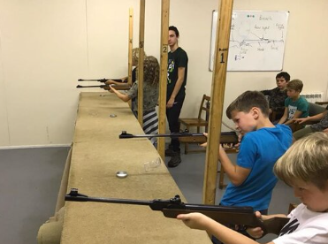
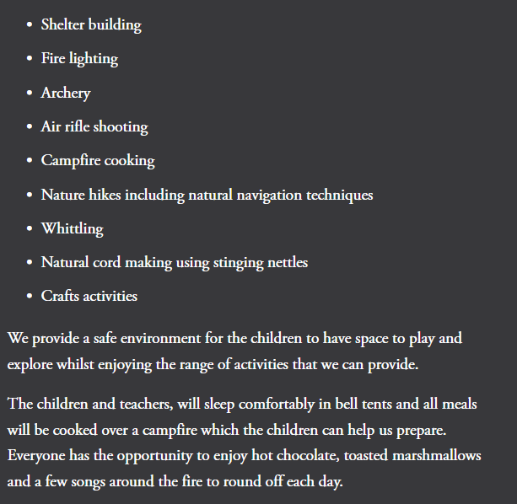
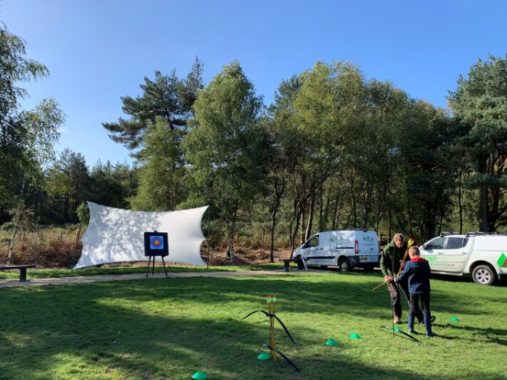

Activities

Slide 9
What will the day look like at Fresh Air Club?
MONDAY:
9am Depart HJS
10am Arrive at Fresh Air Club
2pm - 5pm: Afternoon activities.
6pm: Evening meal.
7pm - 9:00pm: Evening activities.
9:00pm - 10pm: Settling down for the night.
10:00pm: Lights out.
TUESDAY:
Wake up at 7am and get washed and dressed ready for breakfast.
9am - 12:30pm: Morning activities.
12:30pm: Lunch.
1:30pm - On coach to head back to school for a 2:30 arrival.

Slide 10
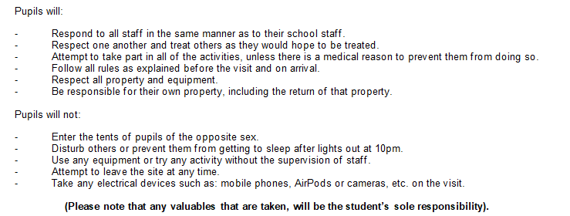
Code of conduct - emailed tomorrow

Slide 11
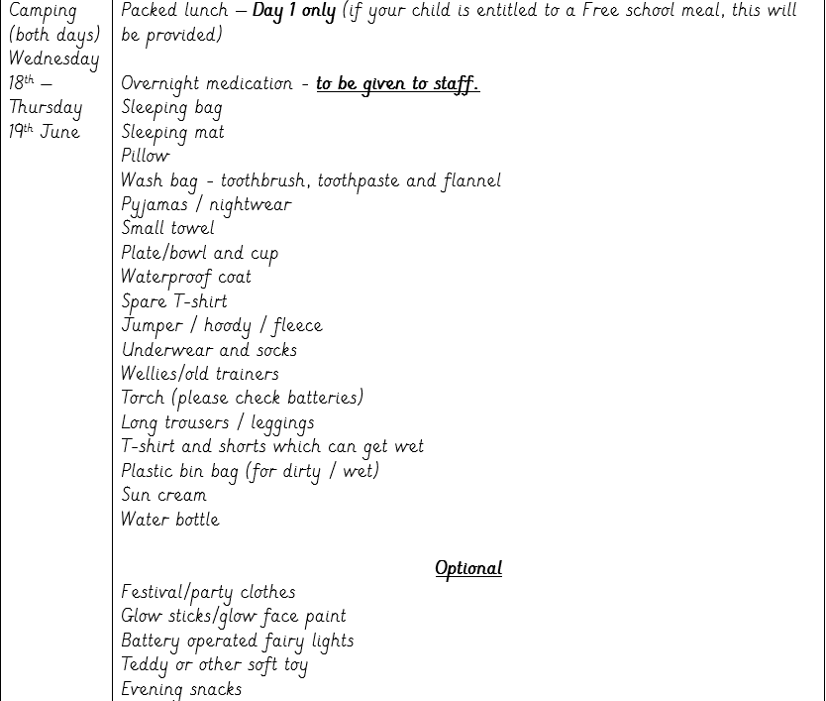
What does my child need to pack?

Slide 12


Monday - Paulton’s Park
Return to school approx 5:20

Slide 13
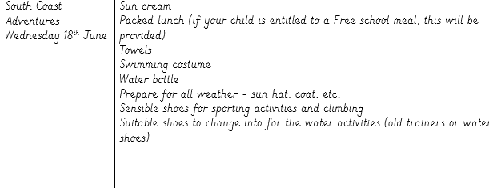
Tuesday - South Coast Adventures
Approx return 5:20

Slide 14


Slide 15
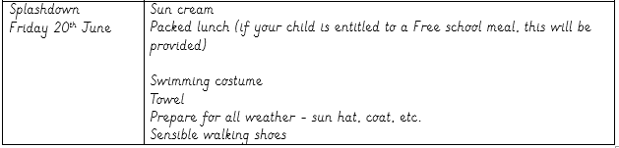
Friday - Splashdown

Slide 16
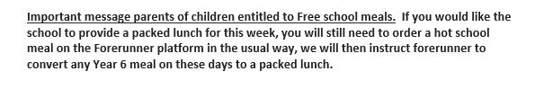

Important information:

Slide 17
Frequently asked questions
Can my child bring a mobile phone?
No - this is for safeguarding reasons. However, they can leave them in the school office as they usually would.
How do I contact you in case of emergency?
During the hours of the school day, contact the school office (01202 659290). Outside of school hours (6pm - 10pm), contact the emergency mobile number (issued on the Monday).

Slide 18
Frequently asked questions
Will you make my child go on certain rides?
No - we will actively encourage children to “have a go” and step out of their comfort zone. We will try our best to group children based on their thrill seeking attitude.

Slide 19
Frequently asked questions
Who will be in my child’s tent?
The children will have all completed a slip with the names of 5/6 pupils they would like in their tent. We will aim to ensure that at least one of those named are in their tent.
My child is a fussy eater. How will you ensure they eat?
Children are usually more experimental with food when around their peers. There is a wide range of food available and no child will go hungry - even the fussiest ones! If you are concerned, please feel free to pack some suitable snacks with your child.

Slide 20
Volunteers

Slide 21
Your child has been looking forward to this week and will have a brilliant time!
They will experience independence, they will develop strong friendships with others and they will try new things and grow in confidence.

Slide 22
KS2 SATs

Slide 23
Aims of the session
The key stage 2 national curriculum tests are designed to test your child’s knowledge and understanding of specific elements of the key stage 2 programmes of study (year 3 through to year 6)
They provide a snapshot of a child’s attainment at the end of the key stage.

Slide 24
SATs
Date for your diary- Monday 12th May - Thursday 15th May
Your child MUST be in school for every test.
SATs party! Friday 16th May 1:30pm - 3pm

Slide 25
SATs Week timetable
Monday: Grammar Spelling and Punctuation test
Tuesday: Reading comprehension test
Wednesday: Arithmetic test and Reasoning paper
Thursday: Final Reasoning paper

Slide 26
During the week
Please ensure your child is in school everyday.
They must be in school on time (we do little warm-ups before each test).
Please don’t book any appointments this week.
If your child is unwell, please let us know immediately.

Slide 27
What is being assessed in Maths?
- Number and place value, approximation and estimation/rounding
- Four rules of calculation
- Fractions, decimals and percentages
- Ratio and proportion
- Algebra
- Measurement
- Geometry: properties of shape
- Geometry: position and direction
- Statistics

Slide 28
Expectations in Maths:
Children should be fluent with counting, number facts and times tables.
This is essential to be able to complete the structured test in the time allowed.

Slide 29
What types of questions will be asked in the maths tests?
The arithmetic test will check that the children can select the most efficient method in order to complete it quickly.
All the questions in the reasoning papers will have a context and can be read to the child if requested.

Slide 30
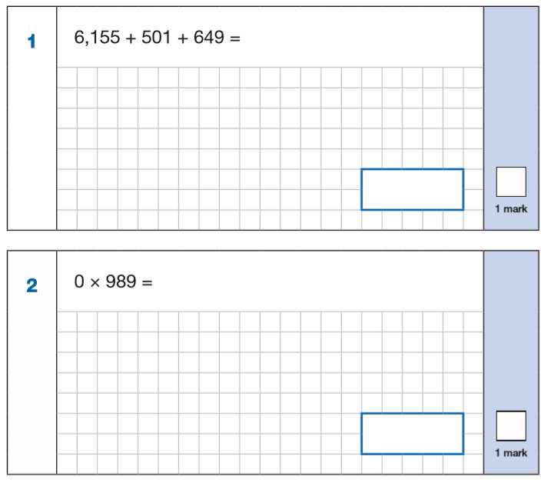
KS2 Arithmetic test
All questions have a grid even when the children may not need it.
https://mathsbot.com/primaryMenu

Slide 31
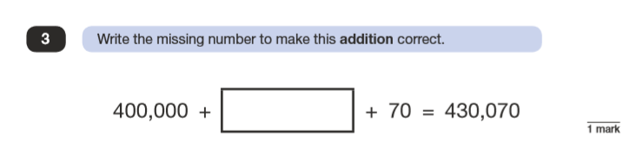
KS2 Reasoning papers
These involve applying their arithmetic knowledge to maths problems.

Slide 32
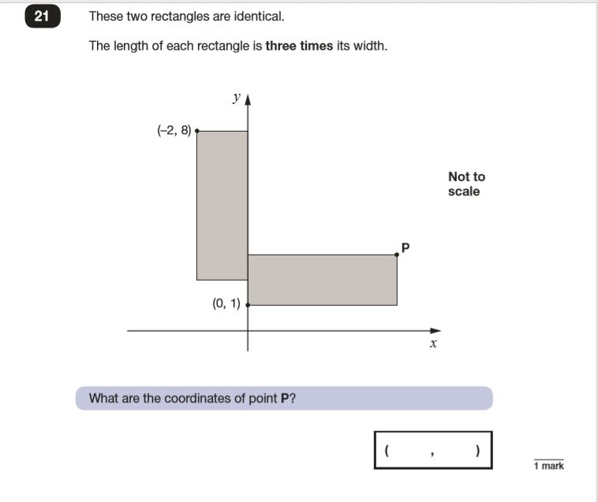
KS2 Reasoning papers
A lot is expected of the children for just one mark!

Slide 33
How to help your child prepare for the maths tests...
Your child was given a study guide earlier this academic year. Please encourage your child to use this study guide to revise from.

Slide 34

How to help your child prepare for the maths tests...
Your child should also have the revision home learning slip in their diary - this has lots of top tips and website to help with revision.

Slide 35
All tests are marked externally.
Reporting the scores:
The raw score (total out of 110) will be converted into a scaled score and each child will receive an overall result indicating whether or not they have achieved the required standard on the test: EXS

Slide 36

Reading test: KS2
Paper 1
60 minutes
50 marks
3 texts to read

Slide 37

What types of questions will be asked in the reading test?
Multiple choice
Ordering
Find and copy
Give evidence
Explain
Predict
Fact/opinion
True/false
Inference

Slide 38
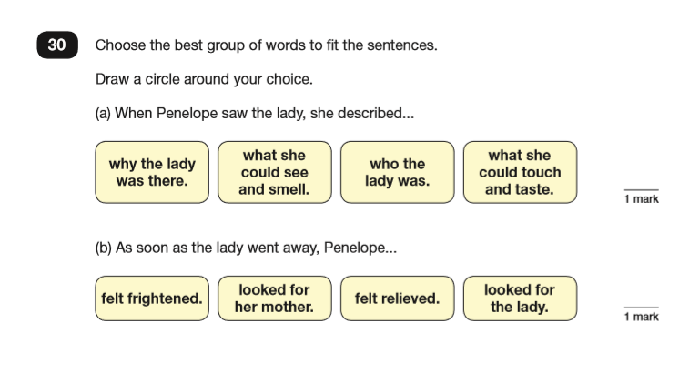

Slide 39
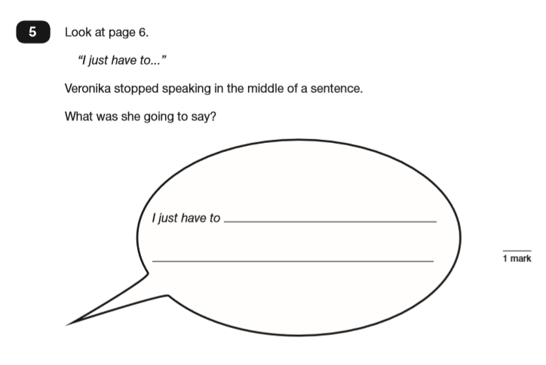
Prediction using inference

Slide 40
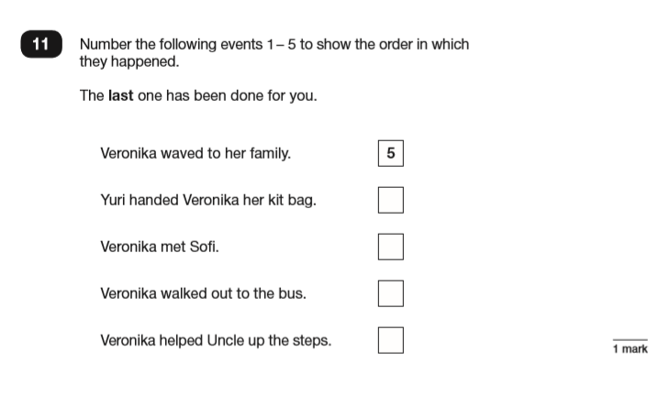
Ordering

Slide 41
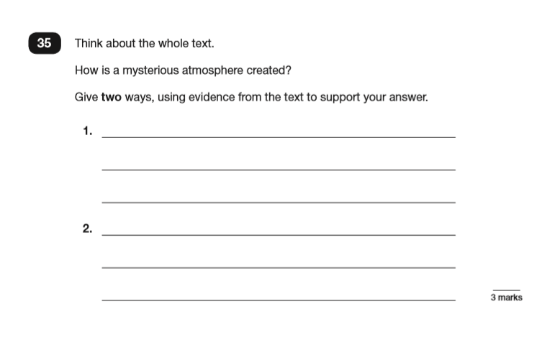

Slide 42

https://www.spreeder.com/app.php

Slide 43
What is being assessed in grammar, punctuation and spelling - otherwise known as SPaG
- Grammatical terms/word classes
- Function of sentences
- Combining words, phrases and clauses
- Verb form, tense and consistency
- Punctuation
- Vocabulary
- Standard English and formality

Slide 44
Test format - SPaG
The SPaG test comprises of 2 tests.
Paper 1: Grammar and punctuation short answer
questions - 45 minutes with a maximum of 50 marks.
Paper 2 - spelling test - 15 minutes long with a maximum of 20 marks.

Slide 45
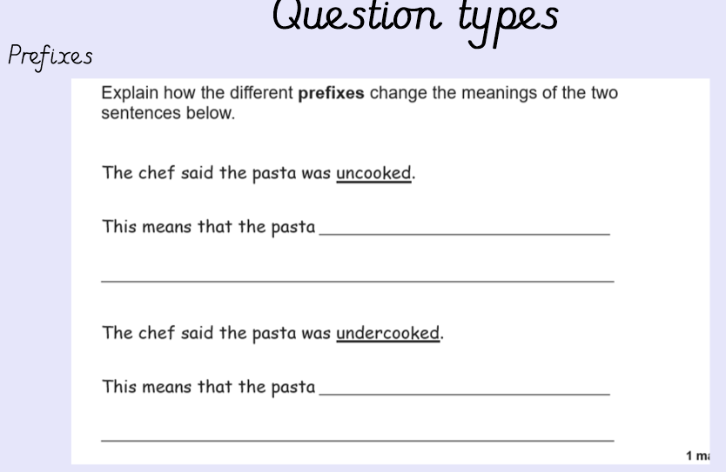

Slide 46

A useful online revision resource

Slide 47
Spelling test
The main trick for success is to start speaking in a ‘spelling voice’.
By doing this, children can hear the letters. ‘government’ ‘dustbin’ ‘different’
Breaking up the word into sounds and syllables can also help with spelling- choc/o/late Feb/ru/ary

Slide 48
Writing:
There is no formal test for writing. The children's writing is assessed throughout their time in Year 6.
There is a moderation process for writing and the work from now until May will be what is judged.

Slide 49
Writing:
Expectations for writing:
evaluate, edit and proof read own writing
precise use of grammar and punctuation in sentence structures
be able to choose the correct genre for the task given and
therefore how to write appropriately for different audiences e.g. formal and informal.

Slide 50

How can you help your child?
Your child received a study guide for maths and SPaG - if you haven't seen it, please ask!
Please use these with your child; it will really prepare them for the tests by supporting the learning taking place in school.

Slide 51
All their test scores are in a table at the back of their diary.
They need about 50% to get EXS and 85% to get GDS.
This can change year by year.

Slide 52

Finally...
In order to relax the children during SATs week itself, we are offering a breakfast club for every Year 6 child - free of charge.
This ensures they arrive relaxed and enjoy breakfast with their friends - which really does lighten their mood and prepare them for the day ahead.

Slide 53
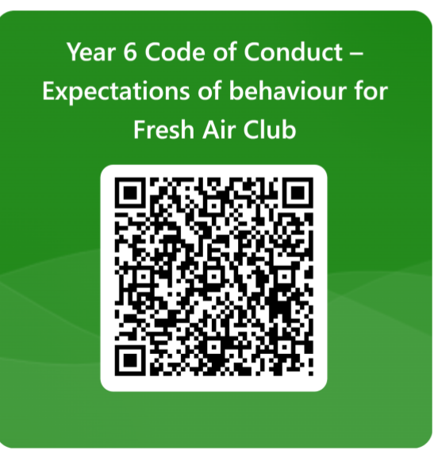
QR Code for Code of Conduct
Please collect a kit list as you leave.

